Slide 1
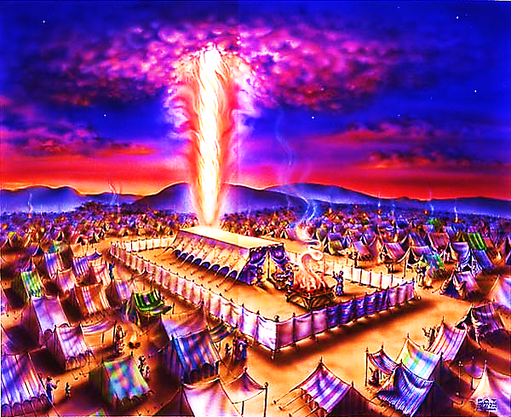
The Tabernacle in the Wilderness pt. 7

Slide 2
Note: Any videos in this presentation will only play online. After you download the slideshow, you will need to also download the videos from YouTube & add them back into your PowerPoint.
We present these messages at Bee Creek Park in College Station, TX. If you would like to watch the video of the service with this message, click here:
http://campaignkerusso.org/?p=10111
We would love to know more about the people who download our lessons & sermons. We invite you to email us & let us know where & how you use them.
info@ckbrazos.org

Slide 3
Review
God always & only longs to be with man.
All He ever does is seek to make this happen.
It is the only thing He cares about!

Slide 4
The bible is one story… It is the story of God trying to make a way where He can dwell with men.
From Exodus to Revelation

Slide 5
The Tabernacle is actually God’s blueprint of His gospel plan.

Slide 6
Everything About the Tabernacle Points to Jesus.

Slide 7
It was a tent, made of mere fabric, yet it was full of the glory of God!

Slide 8
His Body was His Tent – He Wanted to Live with Us
Human Flesh is Very Fragile Tent Material – It Can Feel Pain – It Can be Broken

Slide 9
The Pure White Linen Fence: This fence formed a pure white barrier around the house of God
“Make a courtyard for the Holy Tent… These curtains must be made from fine linen.”
Ex. 27:9
The white fence kept out the impure Israelites. It kept God’s tent holy.

Slide 10
“And the Lamb’s bride has made herself ready. Fine linen was given to the bride for her to wear. The linen was bright and clean.” Rev. 19:7,8

Slide 11
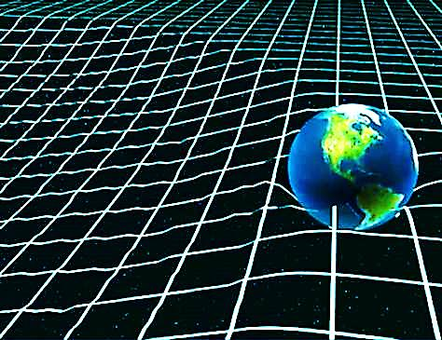
Today we are going to look at the tent itself and the first of it’s four coverings.
God was the first tent maker:
“God sits on his throne above the circle of the earth, and compared to him, people are like grasshoppers. He stretches out the skies like a piece of cloth and spreads them out like a tent to sit under.” Isaiah 40:22
His tent is called the Heavens, and it is wonderful.
Scientists agree that the universe is best described as a sheet of fabric that wraps around the planets and stars.

Slide 12
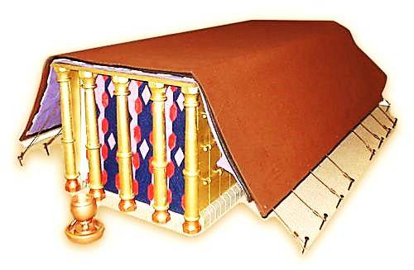
The Hebrews tent was not as wonderful as the Heavens, but it was pretty special.
The Tabernacle was built using very expensive materials such as gold, silver, bronze, and special cloth.

Slide 13
The gold in the Tabernacle weighed over a ton. Today, the cost would be more than a million.
The whole structure was mostly wood covered with gold.

Slide 14
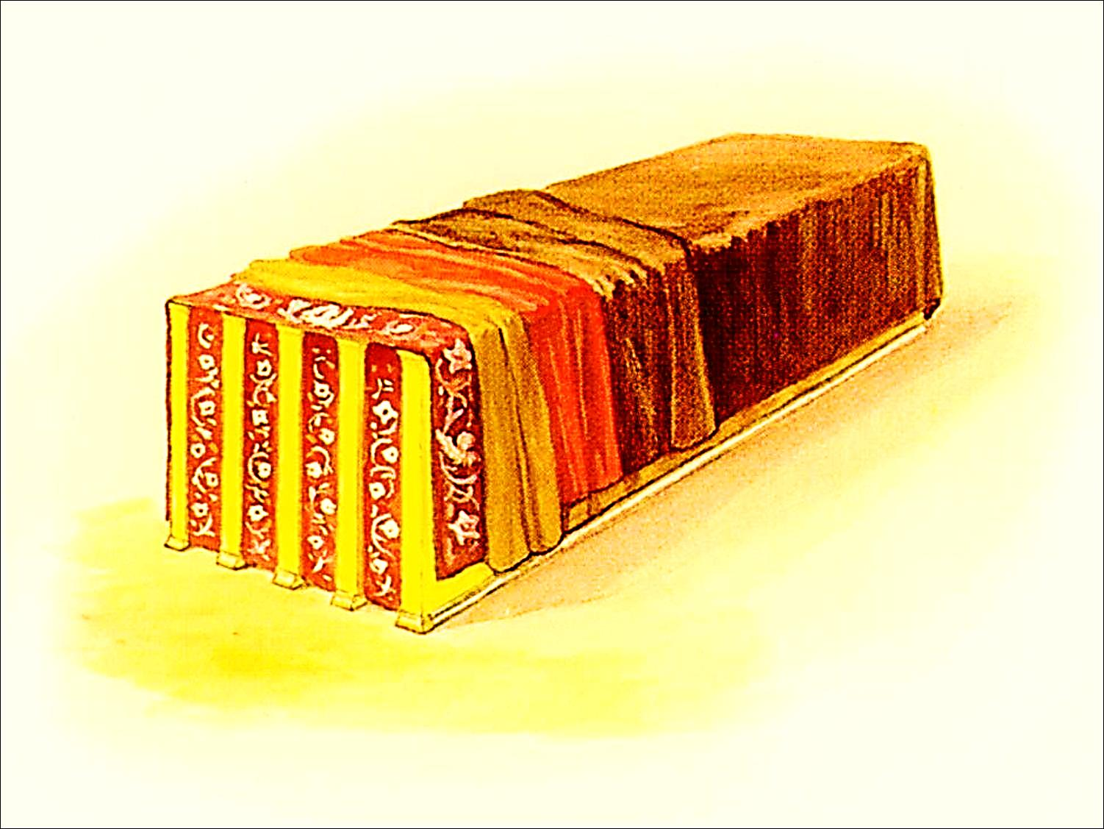
Then, they put four coverings over it.

Slide 15
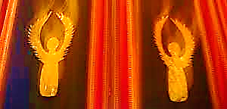
The first covering was the prettiest & priciest. It was made of expensive linen, embroidered by skilled artists, and held together by several golden clasps. Very fancy!
“Make the tabernacle with 10 curtains of very good material, white, blue, purple and red. Tell a wise worker that he must make pictures of angels in the curtains.” Ex. 26:1

Slide 16
The WHITE threads remind us of the sinlessness and purity of Jesus.
“And you know that Jesus came to take away our sins, for there is no sin in him.”
1 Jn. 3:5

Slide 17
The RED threads remind us of our suffering Savior and His BLOOD shed as the price of our salvation:

Slide 18
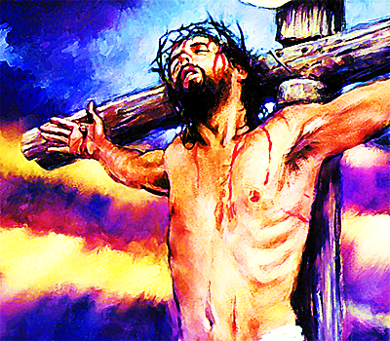
“He suffered the things we should have suffered. He took on himself the pain that should
have been ours…
He was crushed because we had done what was evil.
He was punished
to make us whole again” Is 53:4- 7
“He paid for you with the precious lifeblood of Christ, the sinless, spotless Lamb of God.” I Pet. 1: 19

Slide 19
PURPLE was the color worn by kings. The soldiers used a purple robe to make fun of Jesus for Calling Himself a King.

Slide 20
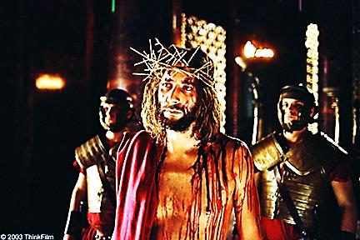
“The soldiers put a purple robe on Jesus. Then they twisted thorns together to make a crown. They placed it on his head.” Mark 15:17
“After they had made fun of him, they took off the purple robe. They put his own clothes back on him. Then they led him out to nail him to a cross.” Mark 15:20

Slide 21
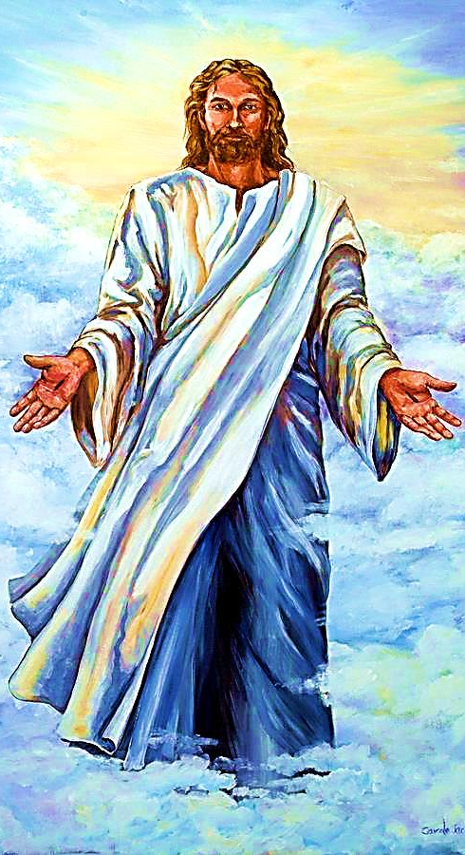
But Jesus is a King, in fact He is the “King of Kings.”
Listen to this vision of Jesus in Heaven:
“And on his robe and on his leg is a name, KING OF KINGS, AND LORD OF LORDS.” Rev. 19:16

Slide 22
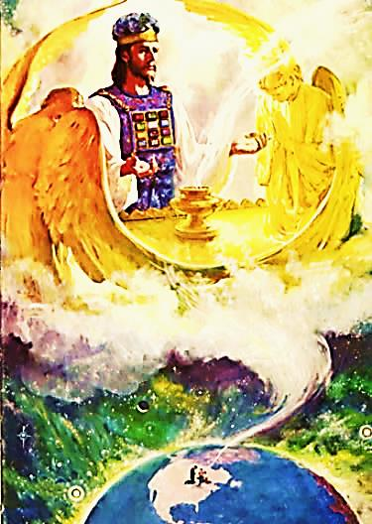
BLUE is the color of the heavens. The Hebrews tent was beautiful, but it was just a copy of the true tabernacle in Heaven.
“Christ did not enter a sacred tent made by people. That tent was only a copy of the true one. He entered heaven itself. He did it to stand in front of God for us. He is there right now.” Heb. 9:24

Slide 23
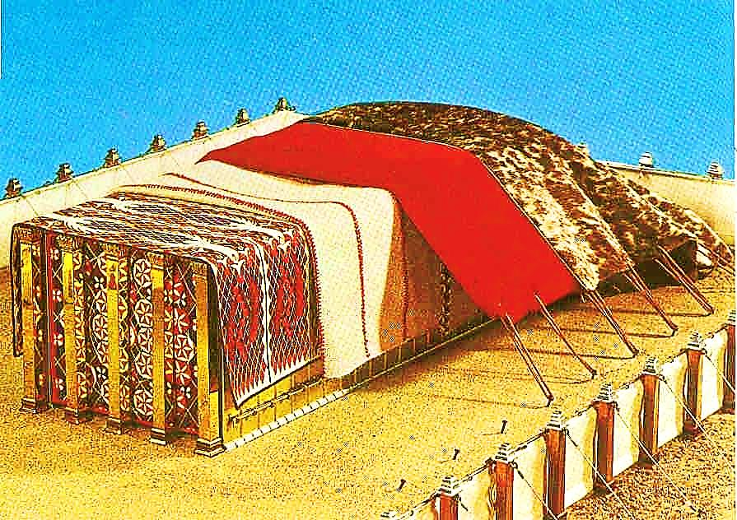
Next, we will look at the other three coverings.

Slide 24
What is the Sinner‘s Prayer?
This is a prayer we can pray when we are ready to admit we are sinners and need Christ’s forgiveness.
It must be prayed with faith in our hearts and a readiness to have a life-changing encounter with Jesus Christ.

Slide 26
John Wesley’s Testimony
“…the preacher was describing the change which God works in the heart through faith in Christ and I felt my heart strangely warmed.”
Disciple’s Testimony
“They said to each other, ‘Did not our hearts burn within us while he talked to us on the road, while he opened to us the Scriptures?’”

Slide 27
A prayer of faith → Pray this prayer if :
If you never have before
You have in the past, but you think it would mean more today
You have been walking afar off and you want to come back
You want to set an example & show others how it is done
You just like to give your heart to Jesus again & again
Faith

Slide 28
We Declare Our Faith Publicly Because Jesus Declared His LOVE Publicly
“If you stand before others and are willing to say you believe in me, then I will tell my Father in heaven that you belong to me.” Mat 10:32

Slide 29
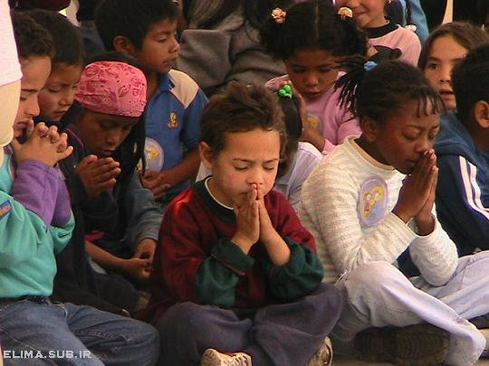
Dear Jesus,
I know I am a sinner & need your forgiveness.
I believe you died for my sins.
I now turn from sin.
Come into my heart I pray.
Do you want to meet Jesus as your savior right now?
Do you believe He died to save you from your sins & that He rose from the dead?
Do you believe that He is waiting to save you right now?

Slide 30
“But some people did accept him. They believed in him, and he gave them the right to become children of God.” John 1:12

Slide 32
“If you openly say, ‘Jesus is Lord’ and believe in your heart that God raised him from death, you will be saved.”
Rom. 10:9
What did you learn today?
What is the meaning of the name-tag?
What have you neen thinking about God lately?
What do you want to tell the world about Jesus?

Slide 33
“Draw near to God, and He will draw near to you…
…Cleanse your hands, you sinners, and make your hearts pure, you who are half-hearted towards God.” James 4:8 WNT

Slide 34
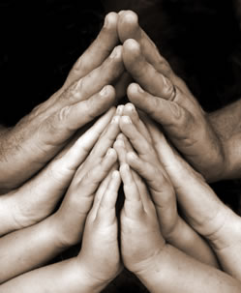
Close in Prayer

Slide 35
Note: Any videos in this presentation will only play online. After you download the slideshow, you will need to also download the videos from YouTube & add them back into your PowerPoint.
We present these messages at Bee Creek Park in College Station, TX. If you would like to watch the video of the service with this message, click here:
http://campaignkerusso.org/?p=10111
We would love to know more about the people who download our lessons & sermons. We invite you to email us & let us know where & how you use them.
info@ckbrazos.org

Slide 36
Welcome to Aggieland Faith Family Style Worship

Slide 37
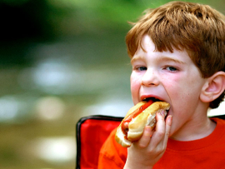
CURRENT SCHEDULE: See www.Aggielandfaith.org
SATURDAY —
At Bee Creek Park
2:00-4:00pm: Through the bible with felt-board stories – plus hot-dogs & drinks
SUNDAY —
At Bee Creek Park
2:00-4pm: Free snacks, drinks, kids crafts, prizes, singing & bible preaching

Slide 38
Would You Like Prayer or Bible Study at Your House?
Personal Prayer: We can come to your home & pray with you, or you can email us when you need prayer.
Home Bible Study: We will come to your home & hold a bible study for you & your friends.
Bible Party: We will hold a Kid’s Bible Party: You provide the food & kids - we will do the bible fun & stories.

Slide 39
Would You Like Visitation?
We will visit a friend, loved one in the hospital or in prison to pray for them & share Christ with them.
Contact: info@aggielandfaith.org

Slide 40
www.aggielandfaith.org
Go here to see pictures & videos
Go here to subscribe to e-mails about changes & cancellations

Slide 41
Note: Any videos in this presentation will only play online. After you download the slideshow, you will need to also download the videos from YouTube & add them back into your PowerPoint.
We present these messages at Bee Creek Park in College Station, TX. If you would like to watch the video of the service with this message, click here:
http://campaignkerusso.org/?10111
We would love to know more about the people who download our lessons & sermons. We invite you to email us & let us know where & how you use them.
info@ckbrazos.org

